Slide 1

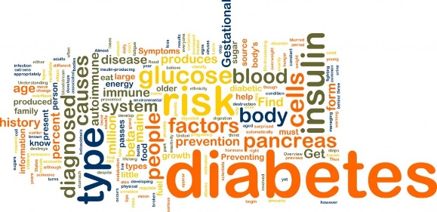
V A A G D E V I E N G I N E E R I N G C O L L E G E DEPARTMENT OF COMPUTER SCIENCE AND ENGINEERING
A MINI PROJECT PRESENTATION ON EARLY PREDICTION OF DIABETES MELLITUS IN PREGNANT WOMEN USING MACHINE LEARNING UNDER THE GUIDANCE OF - V.MADHAVI(Asst.Professor) SUBMITTED BY: M.KAVYA-18UK1A05N5 T.ARUN-17UK1AO5N3 R.SREEJA REDDY-18UK1A05N2 P.SHANTHAN REDDY-17UK1A0524
This Photo by Unknown Author is licensed under CC BY-NC-ND

Slide 2
CONTENTS
Introduction
Proposed system
Requirements
Process of Project
Data flow diagrams
Out put Screens
Conclusion
Future enhancement

Slide 3
Introduction
Diabetes is a chronic disease or group of metabolic disease where a person suffers from an extended level of blood glucose in the body, It may cause many complications.
Diabetes mellitus(DM)is a group of diseases characterized by high levels of blood glucose resulting from defects in insulin production,insulin action,or both.
According to the growing morbidity in recent years, in 2040, the world’s diabetic patients will reach 642 million, which means that one of the ten adults in the future is suffering from diabetes.
In this project, we need to build a machine learning model that can efficiently discover the rules to predict diabetes mellitus of patients based on the given parameter about their health.

Slide 4
Proposed System
In the view of problem statement described in the introduction section,we propose a classification model with boosted accuracy to predict patient.
Classification is one of the most important decision making techniques in many real world problem.
In this work,the main objective is to classify the data as diabetic or non-diabetic and improve the classification accuracy.
It is observed that techniques like Support Vector Machine and Artificial Neural Network are most suitable for implementing the Diabetes prediction system.
The Artificial Neural Network is much similar as natural neural netwok of a brain .Artifical Neural Networks(ANN)typically consists of multiple layers or a cube design,and the signal path traverses from front to back.Back propogation is the use of forward stimulation to reset weights on the “front”neural units and this is sometimes done in combination with training where the correct result is known.
The Support Vector Machine(SVM)was first proposed by Vapnik and SVM is a related supervised learning method always used in medical diagnosis for classification and regression.SVM simultaneously minimize the empirical classification error and maximize the geometric margin.

Slide 5
REQUIREMENTS
Software Requirements
Spyder ide
Python(pandas,numpy,)
Flask
Visual studio community 2019
Libraries to be Installed
Services Used
IBM cloud
Watson studio
Auto Ai

Slide 6
Hardware requirement
Windows 7,8 or 10(32 or 64 bit)
RAM -4GB
Processor:1.5Hz or above •HDD:100GB or above.

Slide 7
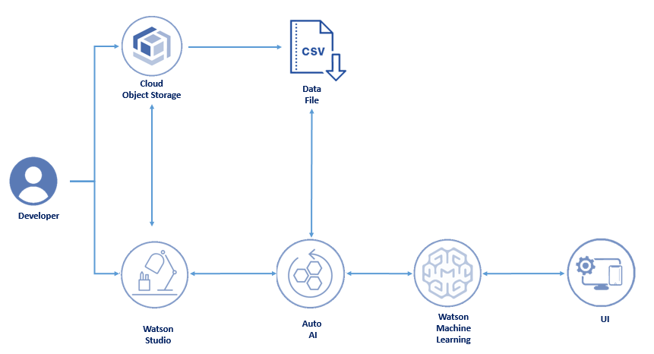
Process of Project:

Slide 8
Data flow diagram
PIMA INDIAN DATASET
Data Preprocessing
Training set
Test set
ML Model
Predicted Outcome

Slide 9
Dataset collection
Data preprocessing
Feature selection
Training model
Machine learning model
Compare to trained model
Web application
Diabetes prediction

Slide 10
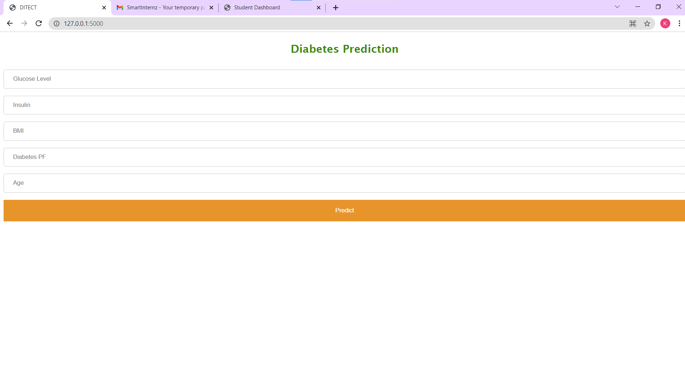
Out put:

Slide 11
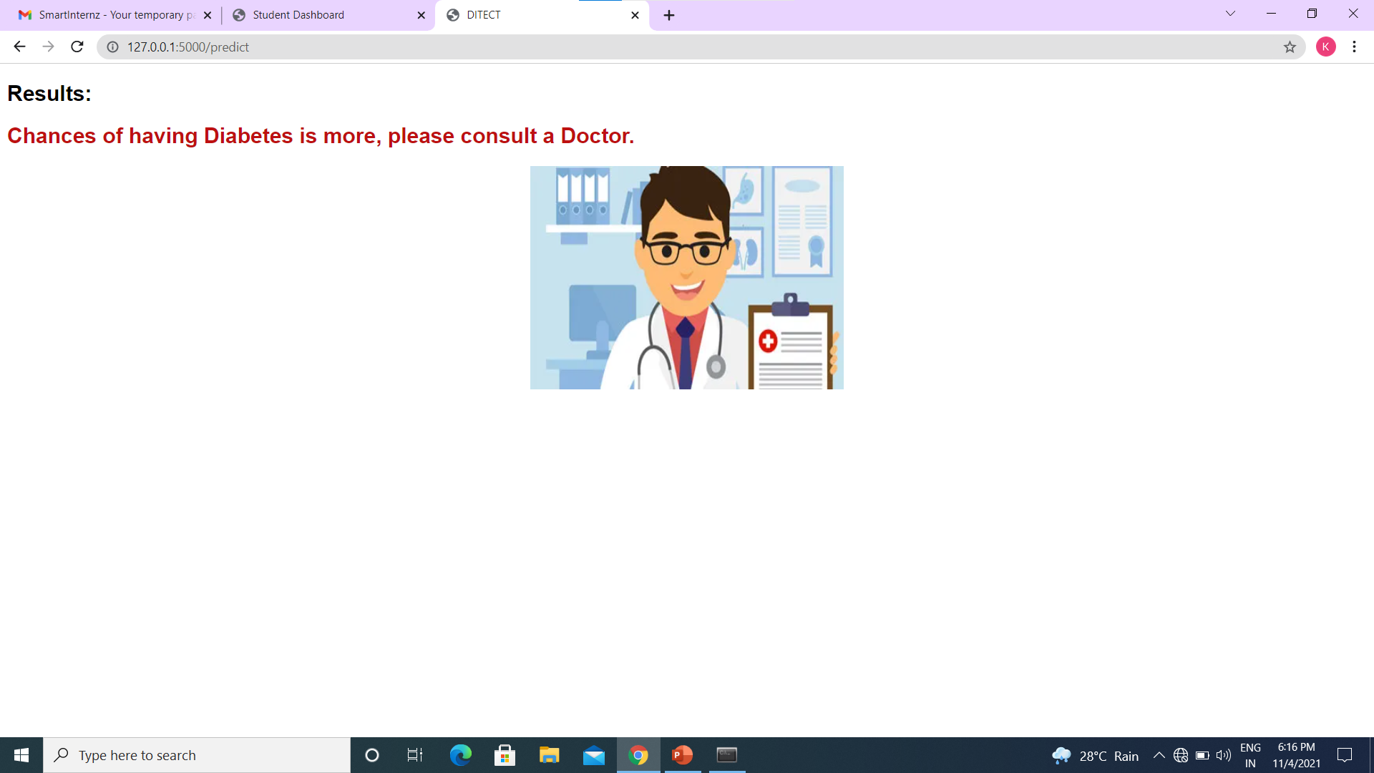
OUT PUT: Having Diabetes

Slide 12
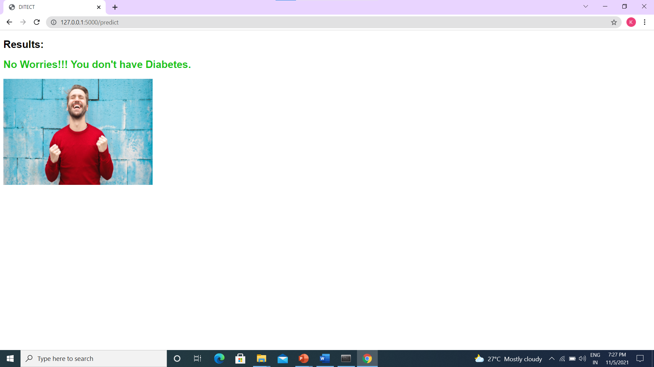
Not having Diabetes:

Slide 13
CONCLUSION
Machine learning has the great ability to revolutionize the diabetes risk prediction with the help of advanced computational methods and availability of large amount of genetic diabetes risk dataset .
Detection of diabetes in its early stages is the key for treatment.
This work has described in its machine learning approach to predict diabetes levels.
The technique may also help researchers to develop an accurate and effective tool that will reach at the table of clinicians to help them make better decision about the disease status.
The technique which accomplishes the highest performance in terms of accuracy is considered to be the best choice.

Slide 14
FUTURE ENHANCEMENT
More parameters and factors would be involved in the future scope of this project.
The accuracy will increase even more when the parameters increase.
Using the traditional techniques and algorithms , we enhance the accuracy by improving the data
The sectors where outcome could be decided on the basis of datasets obtained from previous encounters

Slide 15
THANK YOU

